Slide 1
Supply Chain Analysis-Power BI
Name : jenihelan M
Project id: PTID-CDA-MAR-26-1371
Project code : cdacl – 003
Date : 20/04/2026

Slide 2
INTRODUCTION
Supply chain analysis helps improve business performance
Focus on sales, inventory, delivery, and quality
Dashboard created using Power BI

Slide 3
Analyze product performance
Evaluate inventory management
Study delivery efficiency
Assess supplier quality
Generate business insights
OBJECTIVES

Slide 4
TOOLS & DATA SOURCE
Power BI – Dashboard creation
phpMyAdmin – Data extraction
CSV – Data format

Slide 5
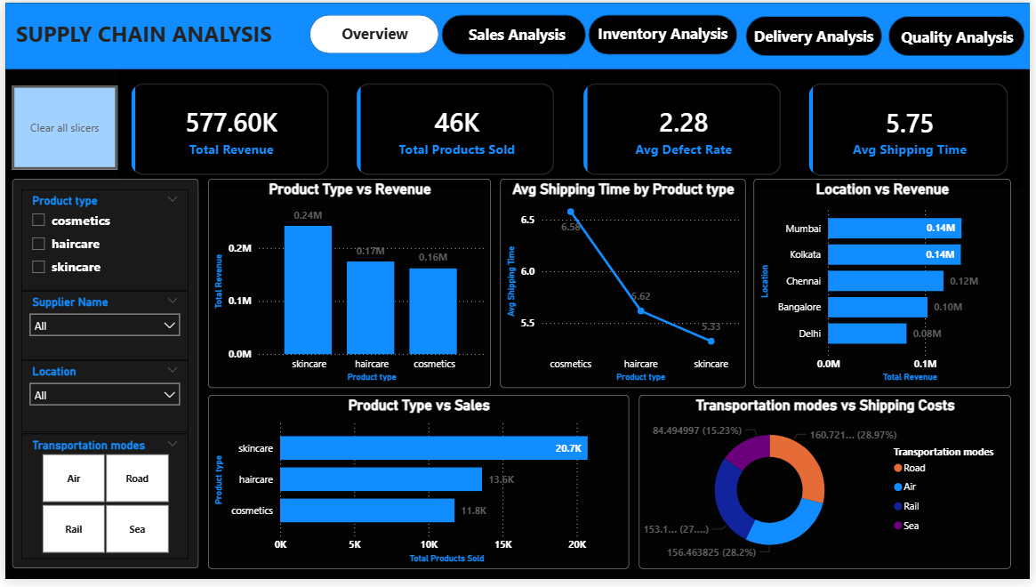
DASHBOARD OVERVIEW

Slide 6
OVERVIEW INSIGHTS
Revenue: 577.60K | Sales: 46K
Skincare → highest revenue & sales
Cosmetics → highest shipping time
Mumbai & Kolkata → top locations
Road & Air → highest shipping cost

Slide 7
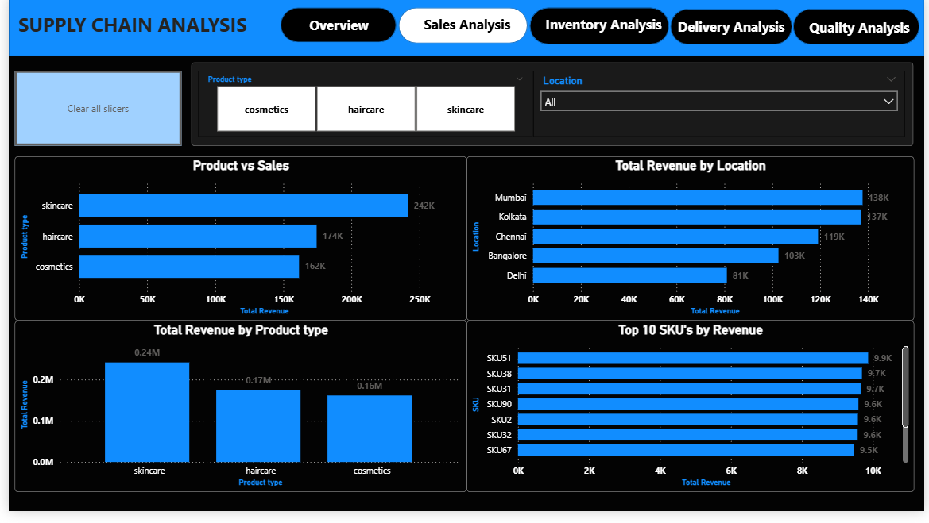
SALES ANALYSIS

Slide 8
SALES ANALYSIS INSIGHTS
Skincare dominates sales & revenue
Few SKUs drive most revenue
Mumbai & Kolkata → strong markets
Delhi → lowest performance

Slide 9
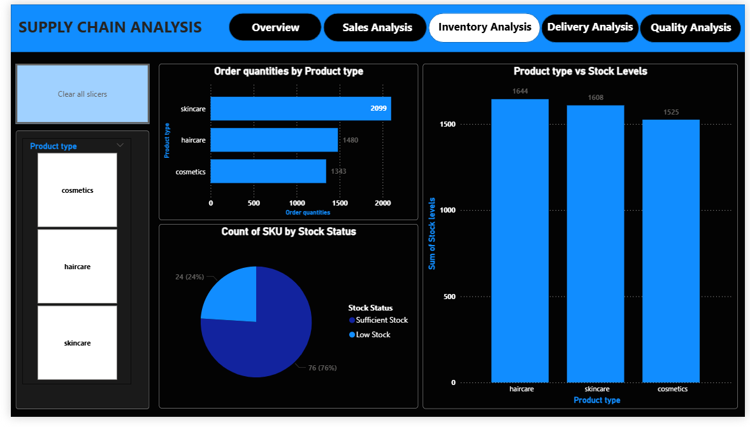
INVENTORY ANALYSIS

Slide 10
INVENTORY ANALYSIS INSIGHTS
76% → sufficient stock
24% → low stock
Skincare → highest demand
Haircare → highest stock levels

Slide 11
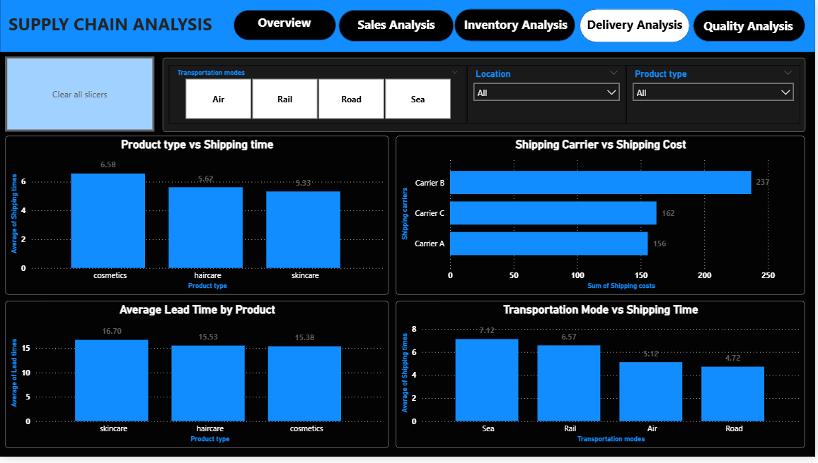
DELIVERY ANALYSIS

Slide 12
DELIVERY ANALYSIS INSIGHTS
Cosmetics → highest shipping time
Skincare → fastest delivery
Road → fastest transport
Sea → slowest but cheapest
Carrier B → highest cost

Slide 13
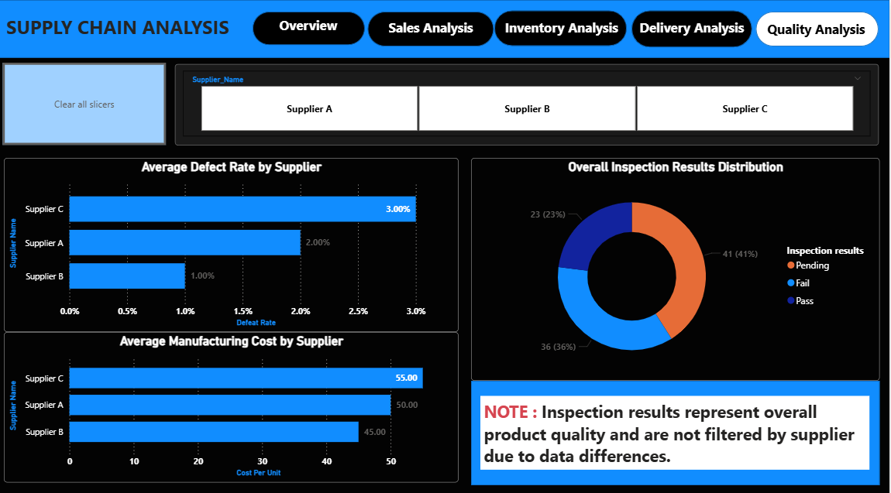
QUALITY ANALYSIS

Slide 14
QUALITY ANALYSIS INSIGHTS
Supplier C → highest defect rate
Supplier B → best quality
Higher cost ≠ better quality
High pending & failed inspections

Slide 15
KEY INSIGHTS
Skincare is top-performing product
Inventory mostly stable
Delivery varies by product & transport
Supplier performance differs
Cost and quality are not directly related

Slide 16
RECOMMENDATIONS
Focus on skincare products
Improve cosmetics delivery
Optimize inventory planning
Use cost-effective transport
Prefer high-quality suppliers
Improve inspection process

Slide 17
CONCLUSION
Dashboard provides clear supply chain insights
Identifies key issues in delivery & quality
Helps improve decision-making
Supports business growth through data analysis

Slide 18
Thank you

